Slide 1
IS4432 Systems Design
Week 8 – Input Design
Adapted by Janet Yu
115/11/07

Slide 2
Agenda
Principles of Input Design
  Online vs Batch Processing
  Capture Data at the Source
  Minimize Keystrokes
  Flow of information on the form
Types of Input
Input Validation
115/11/07

Slide 3
Input Design
Designing the screens for entering highly structured data
Goal is to simply and easily capture accurate information
115/11/07

Slide 4
Basic Principles
Choose between online or batch
Capture data at the source
Minimize keystrokes
115/11/07

Slide 5
Online vs Batch Processing
Online processing / transaction processing
  Immediately records the transaction in the appropriate database
  Used when it’s important to have real time information e.g. reserve airline seat, check out a library book
115/11/07

Slide 6
Online vs Batch Processing
Batch processing
  Collects inputs over time and enters them into the system at one time in a batch
  Used when real time information is not required, to simplify data communications and to save relevant costs
  e.g. time card gathered in batch (for payroll calculation)
115/11/07

Slide 7
Capture Data at the Source
Capture the data in an electronic format at its original source or as close to the original source as possible.
Reduces duplicate work
  (e.g. once by hand, once by keyboard)
Reduces processing time
  (e.g. movement of documentation)
Decreases cost and probability of error
  (e.g. misread handwriting, typo)
115/11/07

Slide 8
Source Data Automation
Using special hardware devices to automatically capture data without requiring anyone to type it:
  bar code readers
  magnetic stripe readers
  smart cards
  optical character recognition (OCR)
  RFID
115/11/07

Slide 9


Barcode
Linear (also called 1 dimensional) barcodes
Matrix (also called 2 dimensional) barcodes
http://www.gs1.org/barcodes
115/11/07

Slide 10
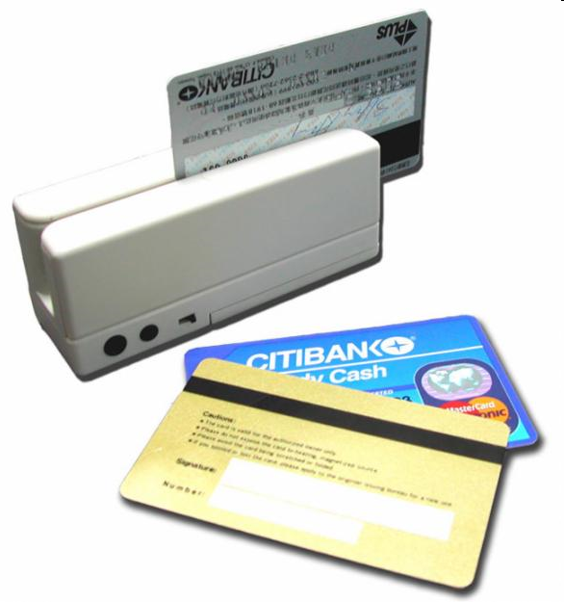
Magnetic Stripe Readers
Source: http://images04.olx.com
http://thecoolgadgets.com/mophies-iphone-credit-card-reader-using-sony-felica-technology/
115/11/07

Slide 11
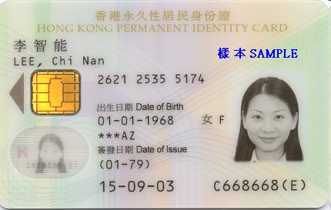

Smart Cards
Card with embedded integrated circuits that can process data
Contact smart card
Contactless smart card
115/11/07

Slide 12
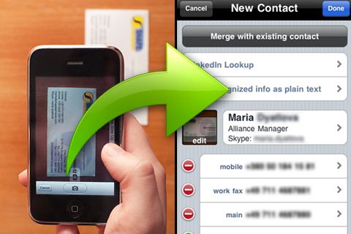
OCR
Optical character recognition
Conversion of images of text into characters
http://www.shapeservices.com/en/products/details.php?product=bcr
115/11/07

Slide 13
RFID
Radio-frequency identification
Sometimes called ‘smart labels’
Incorporate RFID tag into a product for identification and tracking
Using radio frequency
Active RFID tags - contain a battery and can transmit signals autonomously
Passive RFID tags - require an external source to provoke signal transmission
115/11/07

Slide 14
Minimize Keystrokes
Never ask for information that can be obtained in another way (e.g. by retrieving it from a database)
List selection is more efficient than entering information. Selecting also reduces errors.
Use default values wherever possible e.g. billing address is default to be residential address.
115/11/07

Slide 15
Types of Inputs
115/11/07

Slide 16
Flow of Information
The order of information on the form should match the natural flow of information from the data source.
Data entry forms should match paper forms used to initially capture the data.
115/11/07

Slide 17
Types of Inputs
Textbox is used to enter text
Number box (date is a special of number) is used to enter number
Selection box is used to select a value from a predefined list. The items in the list should be in some meaningful order.
115/11/07

Slide 18
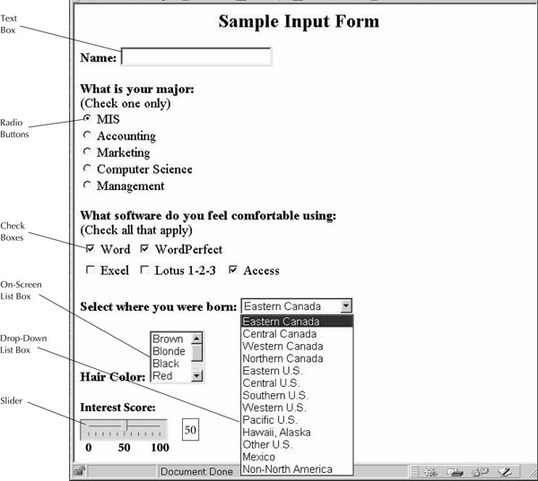
Figure 11.14
115/11/07

Slide 19
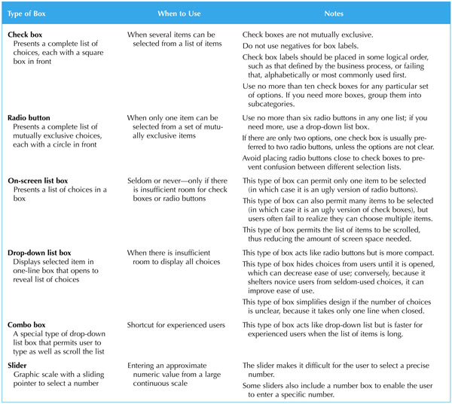
Types of Selection Box
Figure 11.15
115/11/07

Slide 20
Types of Selection Box
115/11/07

Slide 21
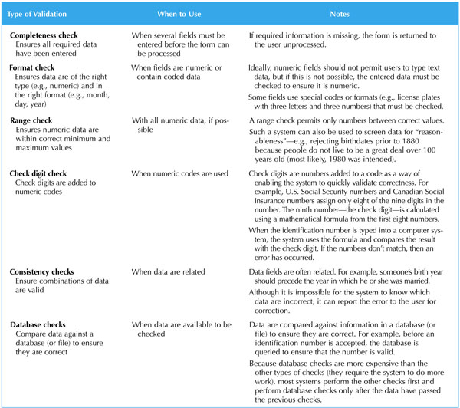
Input Validation
Figure 11.16
115/11/07

Slide 22
Input Validation
115/11/07

